Slide 1
DIGITAL DC-DC BUCK CONVERTER
By:
Mohammad Kasim Ali
Bahaa Miari

Slide 2
Agenda
Background
Project definition and goals
Alternative solutions
Architectural design of the selected solution
Status - What has been done
Tasks and schedule for the remaining part

Slide 3
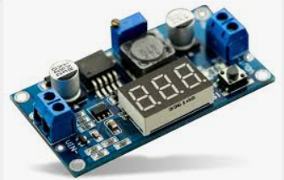
Background
A buck converter is a type of DC-DC power converter circuit used to step down voltage from a higher level to a lower level efficiently.
It is widely used in various electronic devices, including battery-powered systems, power supplies, and voltage regulation circuits.

Slide 4
Project definition and goals
We need to implement a digital voltage converter that reduces the input voltage to a desired output voltage.
The implementation is controlled by a feedback system and a PID digital controller.
Describe the circuit components and flow digitally.
The implementation handles a time – variant load.

Slide 5
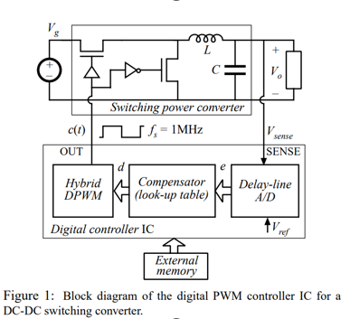
Alternative solutions
the A/D converter, the compensator and the digital pulse-width modulator (DPWM), are introduced to meet the requirements of high-speed dynamic response, tight output voltage regulation and programmability without external passive components.
The DPWM has 8-bit resolution and generates the switching frequency of 1 MHz.

Slide 6
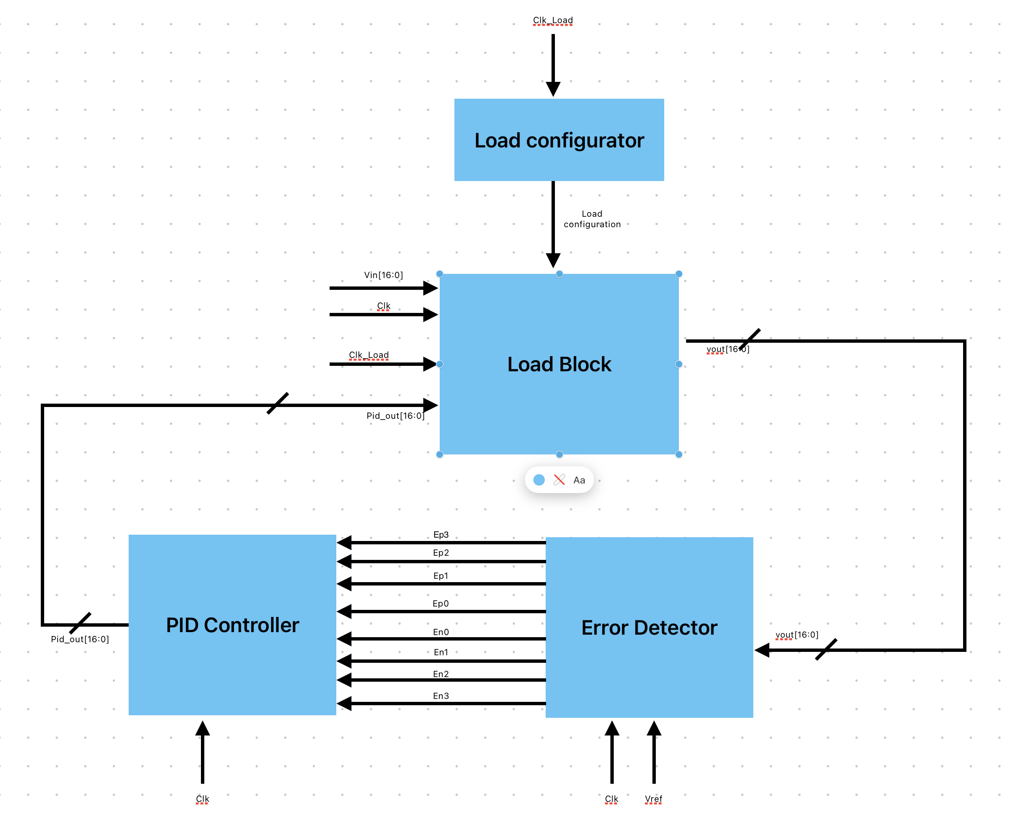
Architectural design of the selected solution

Slide 7
Architectural design
Digital implementation with feedback system that includes PID controller.
Mapping and description of the analog behavior of the circuit.
We chose that each lsb of the signals is 1/10,000 [v], it means that 10,000 in decimal equals 1[v].
Actually the user input is vref, and the expected is that vout is follows vref regardless of the time-variant load.
Clk_load = 125MHz, clk = 12.5MHz.

Slide 8
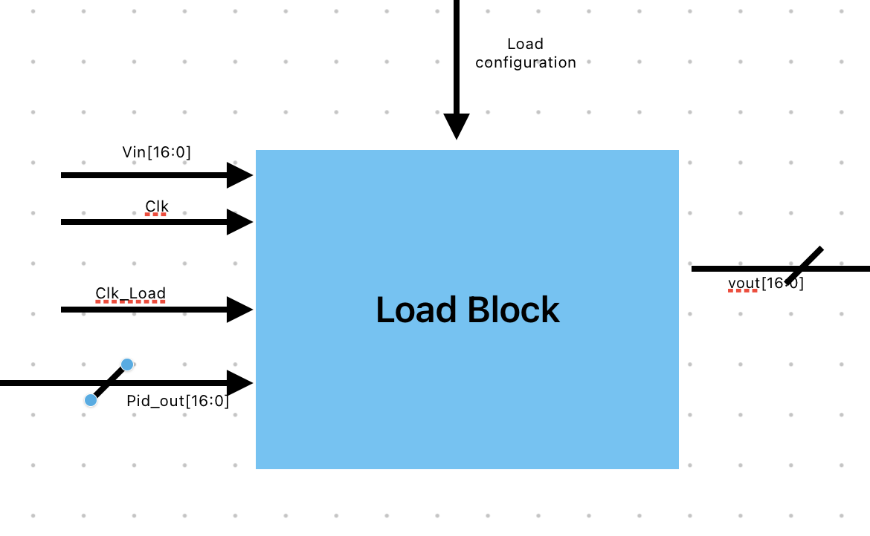
Load Block

Slide 9
In the Load block the load behavior is implemented.
The block inputs are: clk, clk_load, Pid_out[16:0] and the Load configuration. The block output is vout[16:0]. It is the circuit’s output.
The block handles a time-variant load, related to clk_load.

Slide 11
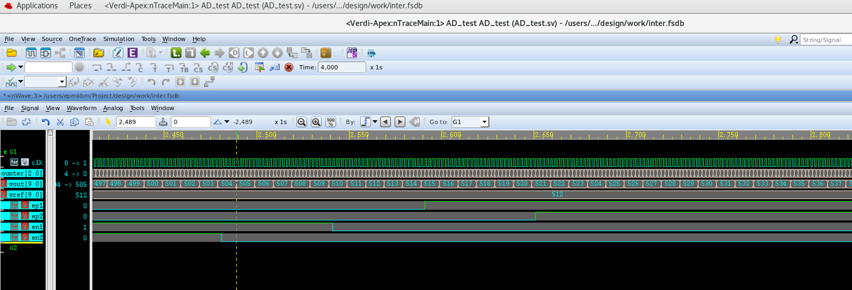
Simulation for Error Detector

Slide 12
Tasks and schedule for the remaining part
Implement various configurations of load files.
Simulate the load file.
Implement the PID controller, simulate it and find the optimal values of the controller to maintain the desired output voltage.
Integration.
Summary, conclusion and final report.

